Slide 1


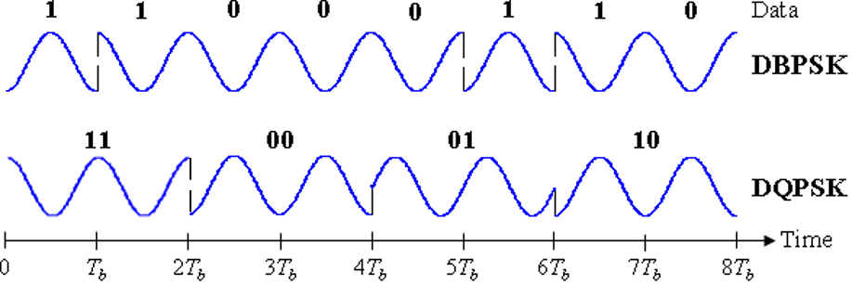
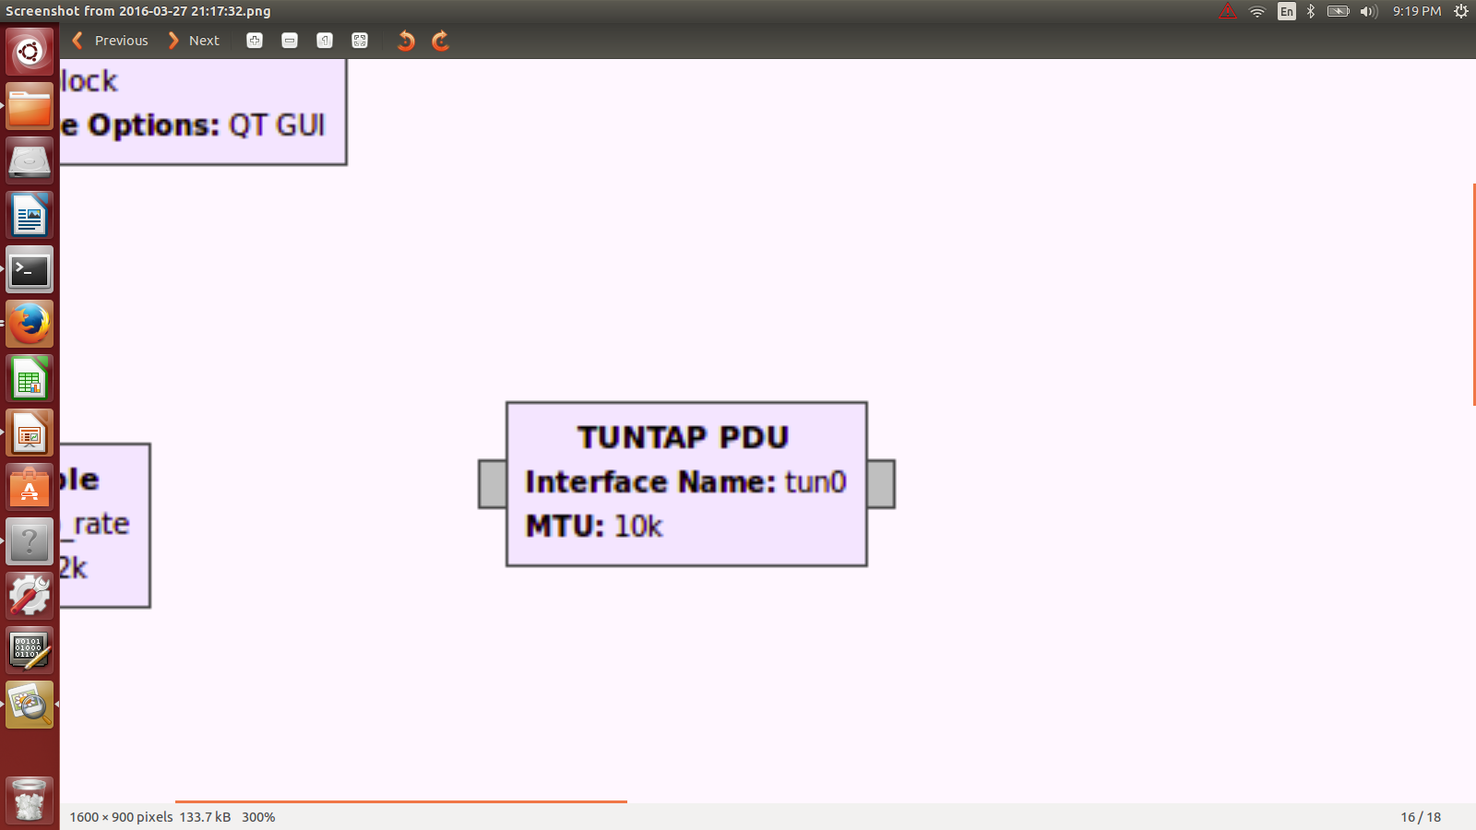
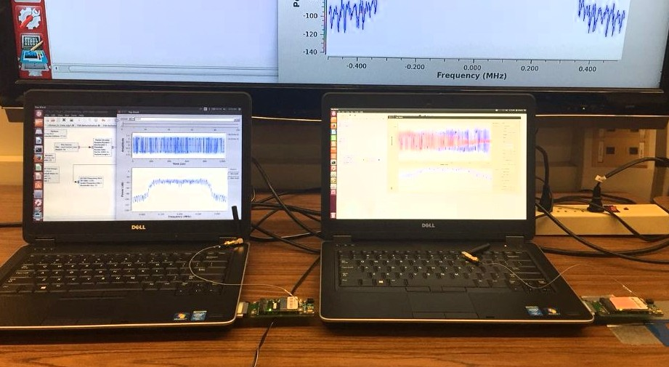
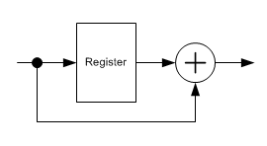
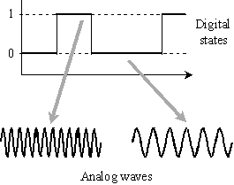
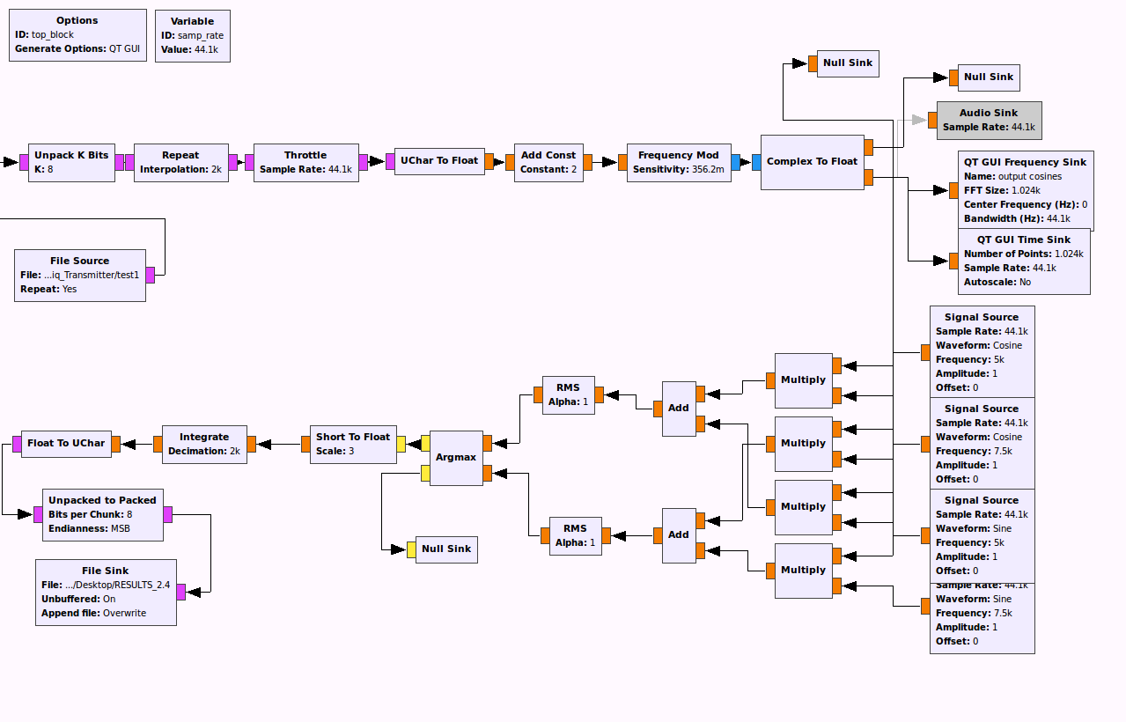
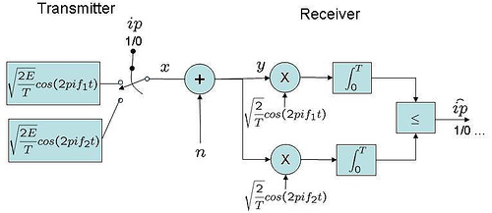
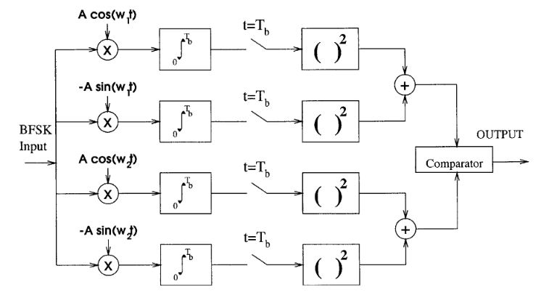
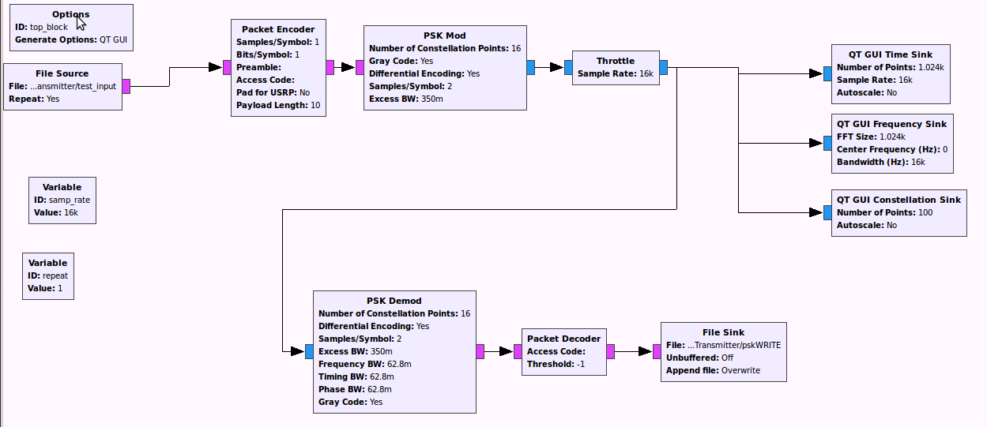
Advisors: Prof. Chih-Chun Wang
Prof. J. V. Krogmeier
Graduate Mentor: A. W. Layton
Members: Shannon Sremac, Htoo Thein, Daniel Alejandro Tejada, Charles Li, Kevin Choi, Zi Jin Lu
Software Defined Radio
Department of Electrical and Computer Engineering
Software Defined Radio
Differential Phase Shift Keying
(DBPSK)
Network Interfaces
Software-defined radio (SDR) is a radio communication technology that is based on software defined wireless communication protocols instead of hardwired implementations.
We aimed to continue the work from last semester’ team and develop a custom wireless protocol and software to enable a point-to-point link using two software defined radios.
Simplified waveform utilizing DBPSK
Software interface that makes an interconnection between a computer and a network.
SDR Generalized System Architecture
The objective is to configure a Tun/Tap device to obtain packets from the interface. Then, convert the packets into samples to inject into the BFSK or DBPSK implementations.
Information is carried in a change in phase. Demodulation consists on comparing the previous wave with the current wave.
The TUN/TAP PDU block in GNU Radio outputs protocol data units. This refers to a group of information added or removed by a layer in the OSI model.
Binary Frequency Shift Keying
(BFSK)
Gnu Radio Models
Discussion & Future Work
GNU Radio is a software development toolkit that provides the signal processing blocks to implement software radios.
A possible way to transmit data with better accuracy for BFSK is to implement a (7,3) Hamming Code.
Illustration of BFSK
Implement DQPSK in order to increase bit transmission rate
BFSK Transmitter and Receiver Flow graph
Develop a point-to-point link to manage data from the cloud (server).
Different schemes for BFSK (One shot analysis)
DBPSK Transmitter and Receiver Flow graph
Relevant Experience
Non-coherent scheme
Experience with communication systems and digital signal processing is preferred.
ECE 264, ECE301, ECE438, and ECE440 are all used in this SDR project.
Skilled in MATLAB and Linux system.
Coherent scheme
Reference:
What is frequency-shift keying (FSK)? - Definition from WhatIs.com. (n.d.). Retrieved November 20, 2015, from http://searchnetworking.techtarget.com/definition/frequency-shift-keying
Bit Error Rate (BER) for frequency shift keying with coherent demodulation. (n.d.). Retrieved November 20, 2015, from http://www.dsplog.com/2007/08/30/bit-error-rate-for-frequency-shift-keying-with-coherent-demodulation/
3. (n.d.). Retrieved November 20, 2015, from https://dspace.mit.edu/bitstream/handle/1721.1/80223/46316132-MIT.pdf?sequence=2
Notes:
1

